Slide 1
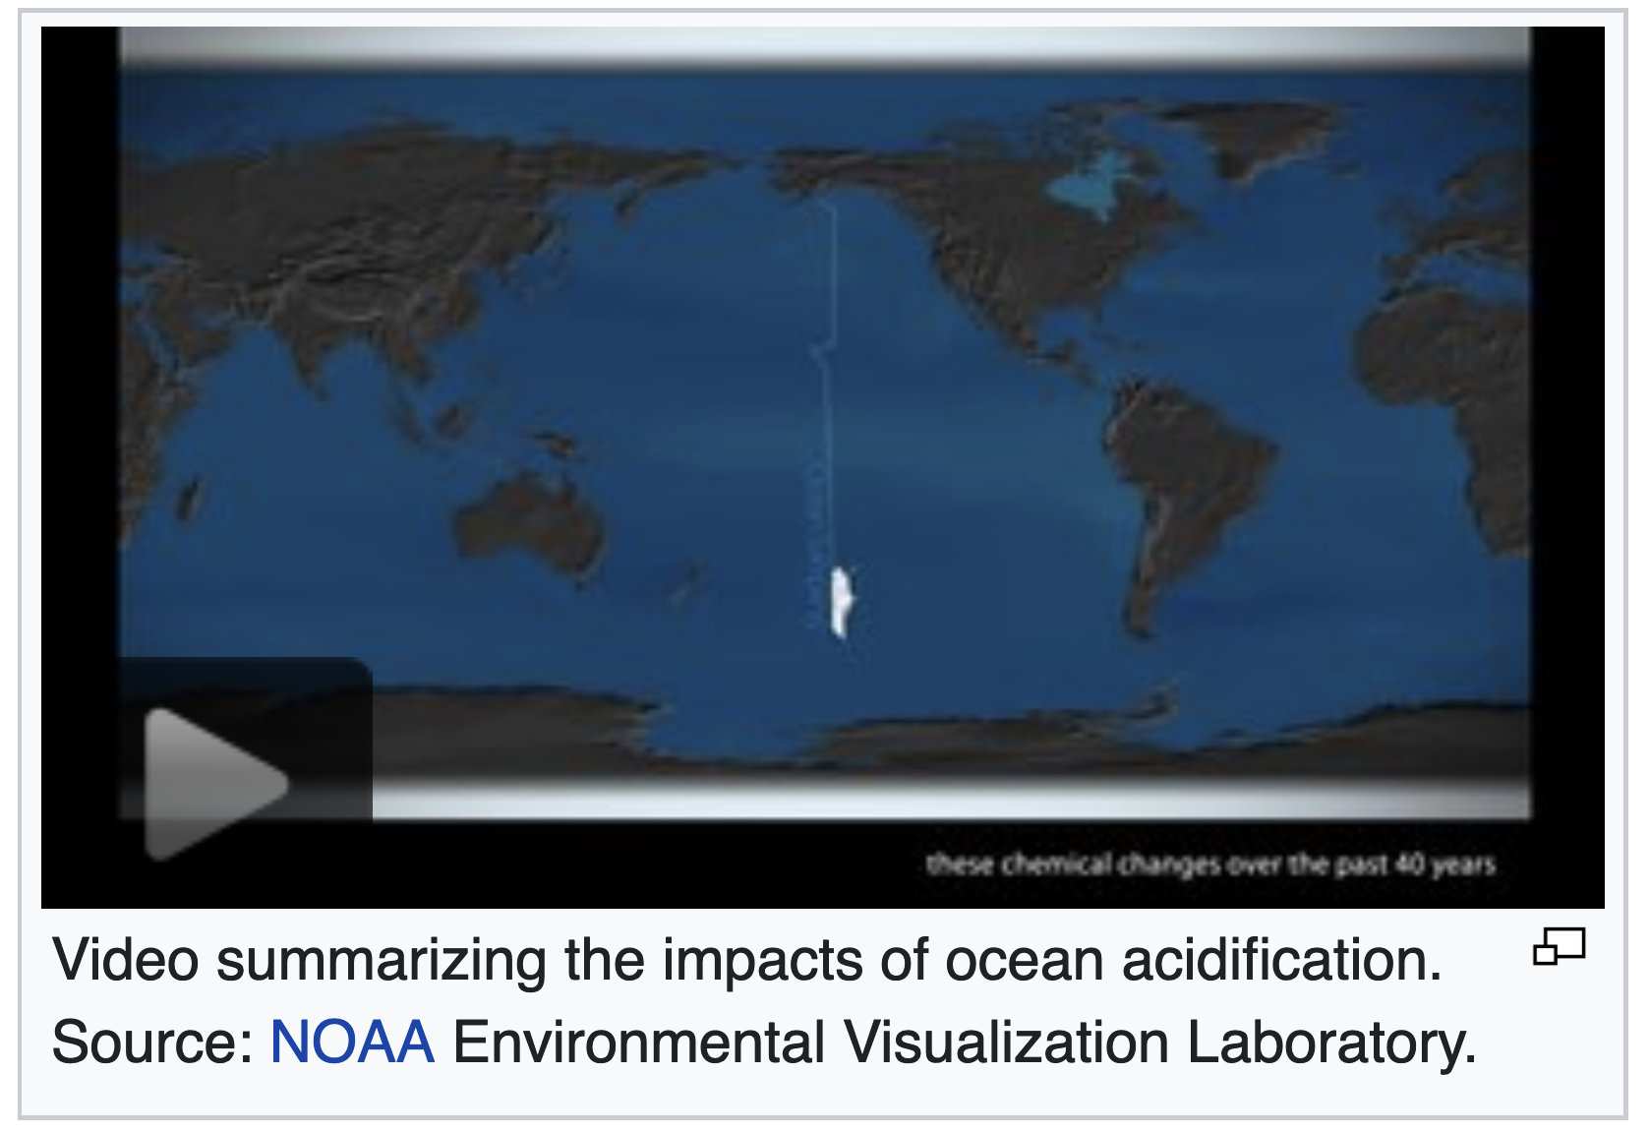
Introduction to ocean acidification
https://en.wikipedia.org/wiki/Ocean_acidification

Slide 2
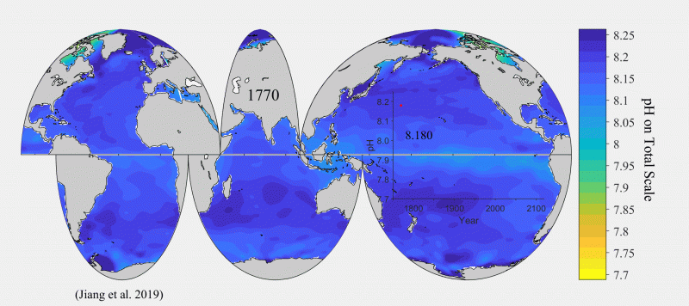
Ocean pH varies according to where (and when) you are
https://toolkit.climate.gov/sites/default/files/Surface_pH_1770_2100_1s.gif

Slide 3
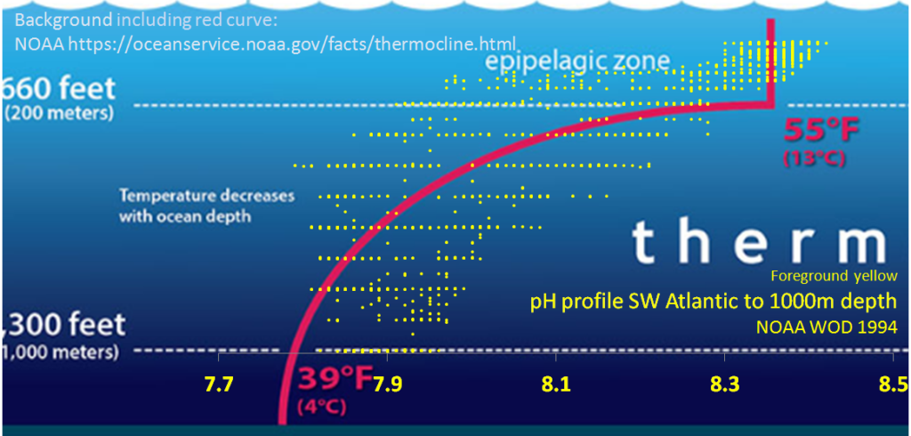
Ocean pH also varies with depth

Slide 4
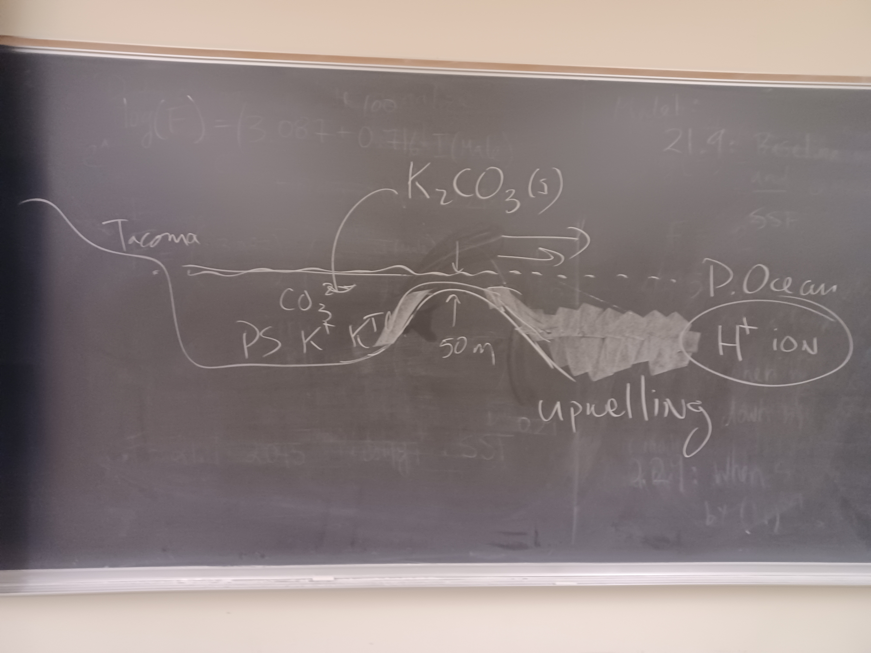
Episodic acidification of Puget Sound

Slide 5
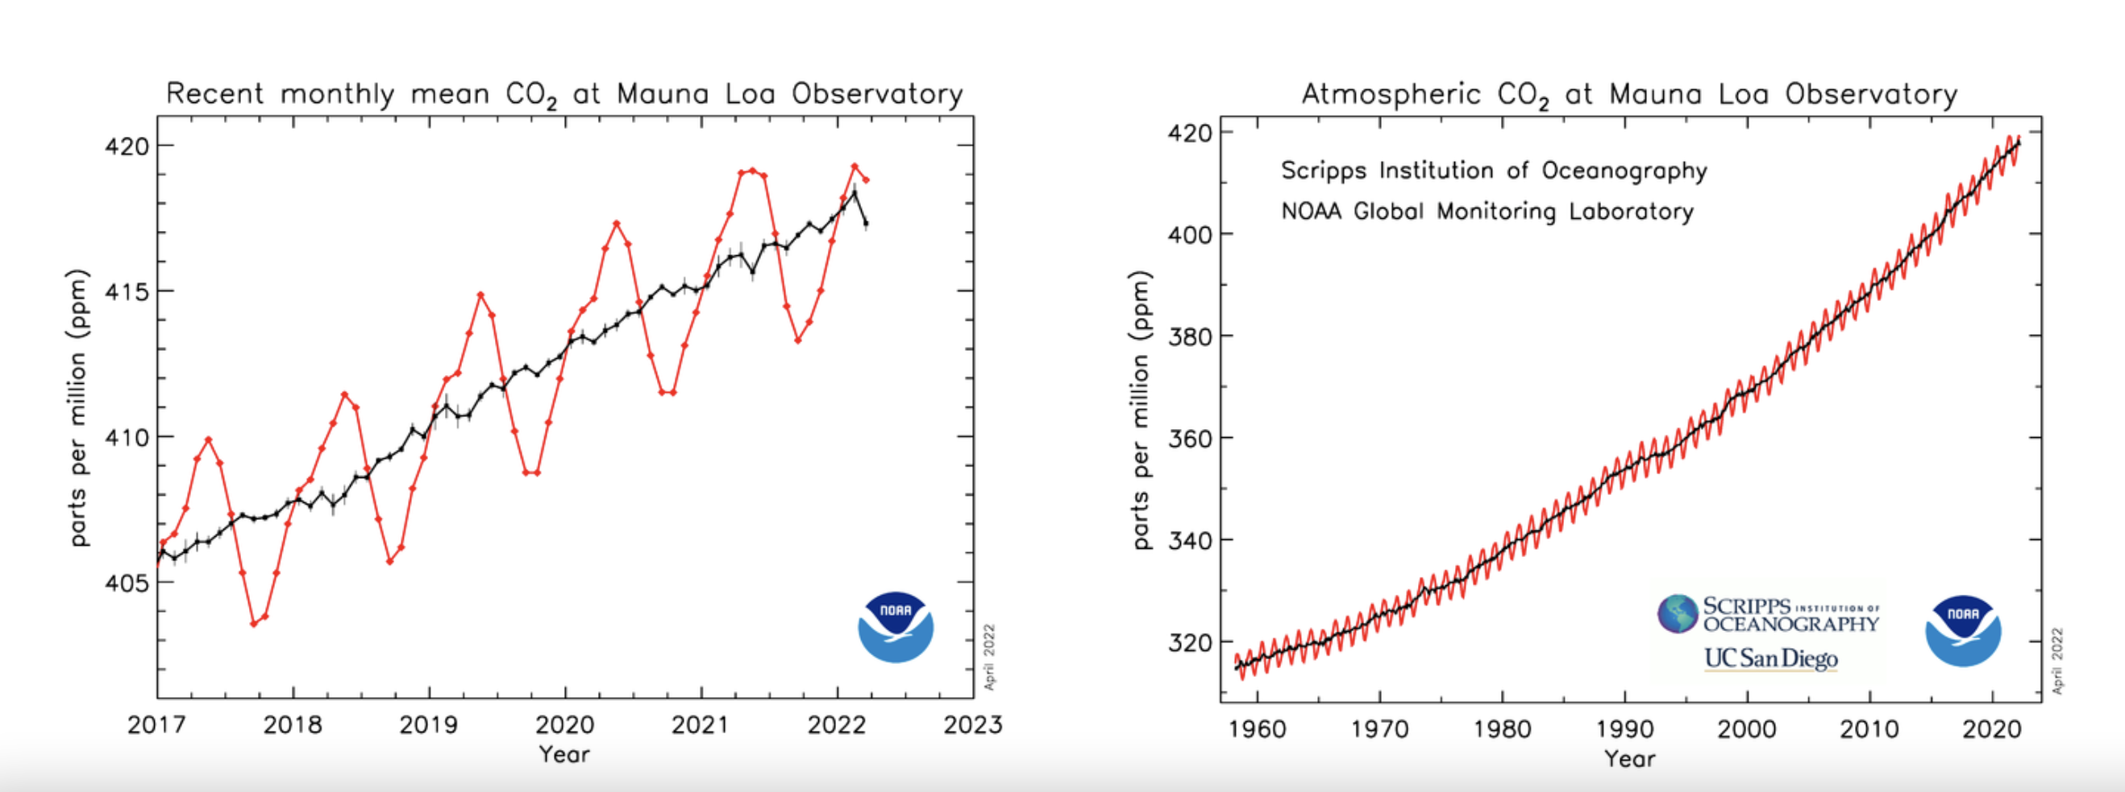
Atmospheric CO₂ measurements at Mauna Loa

Slide 6
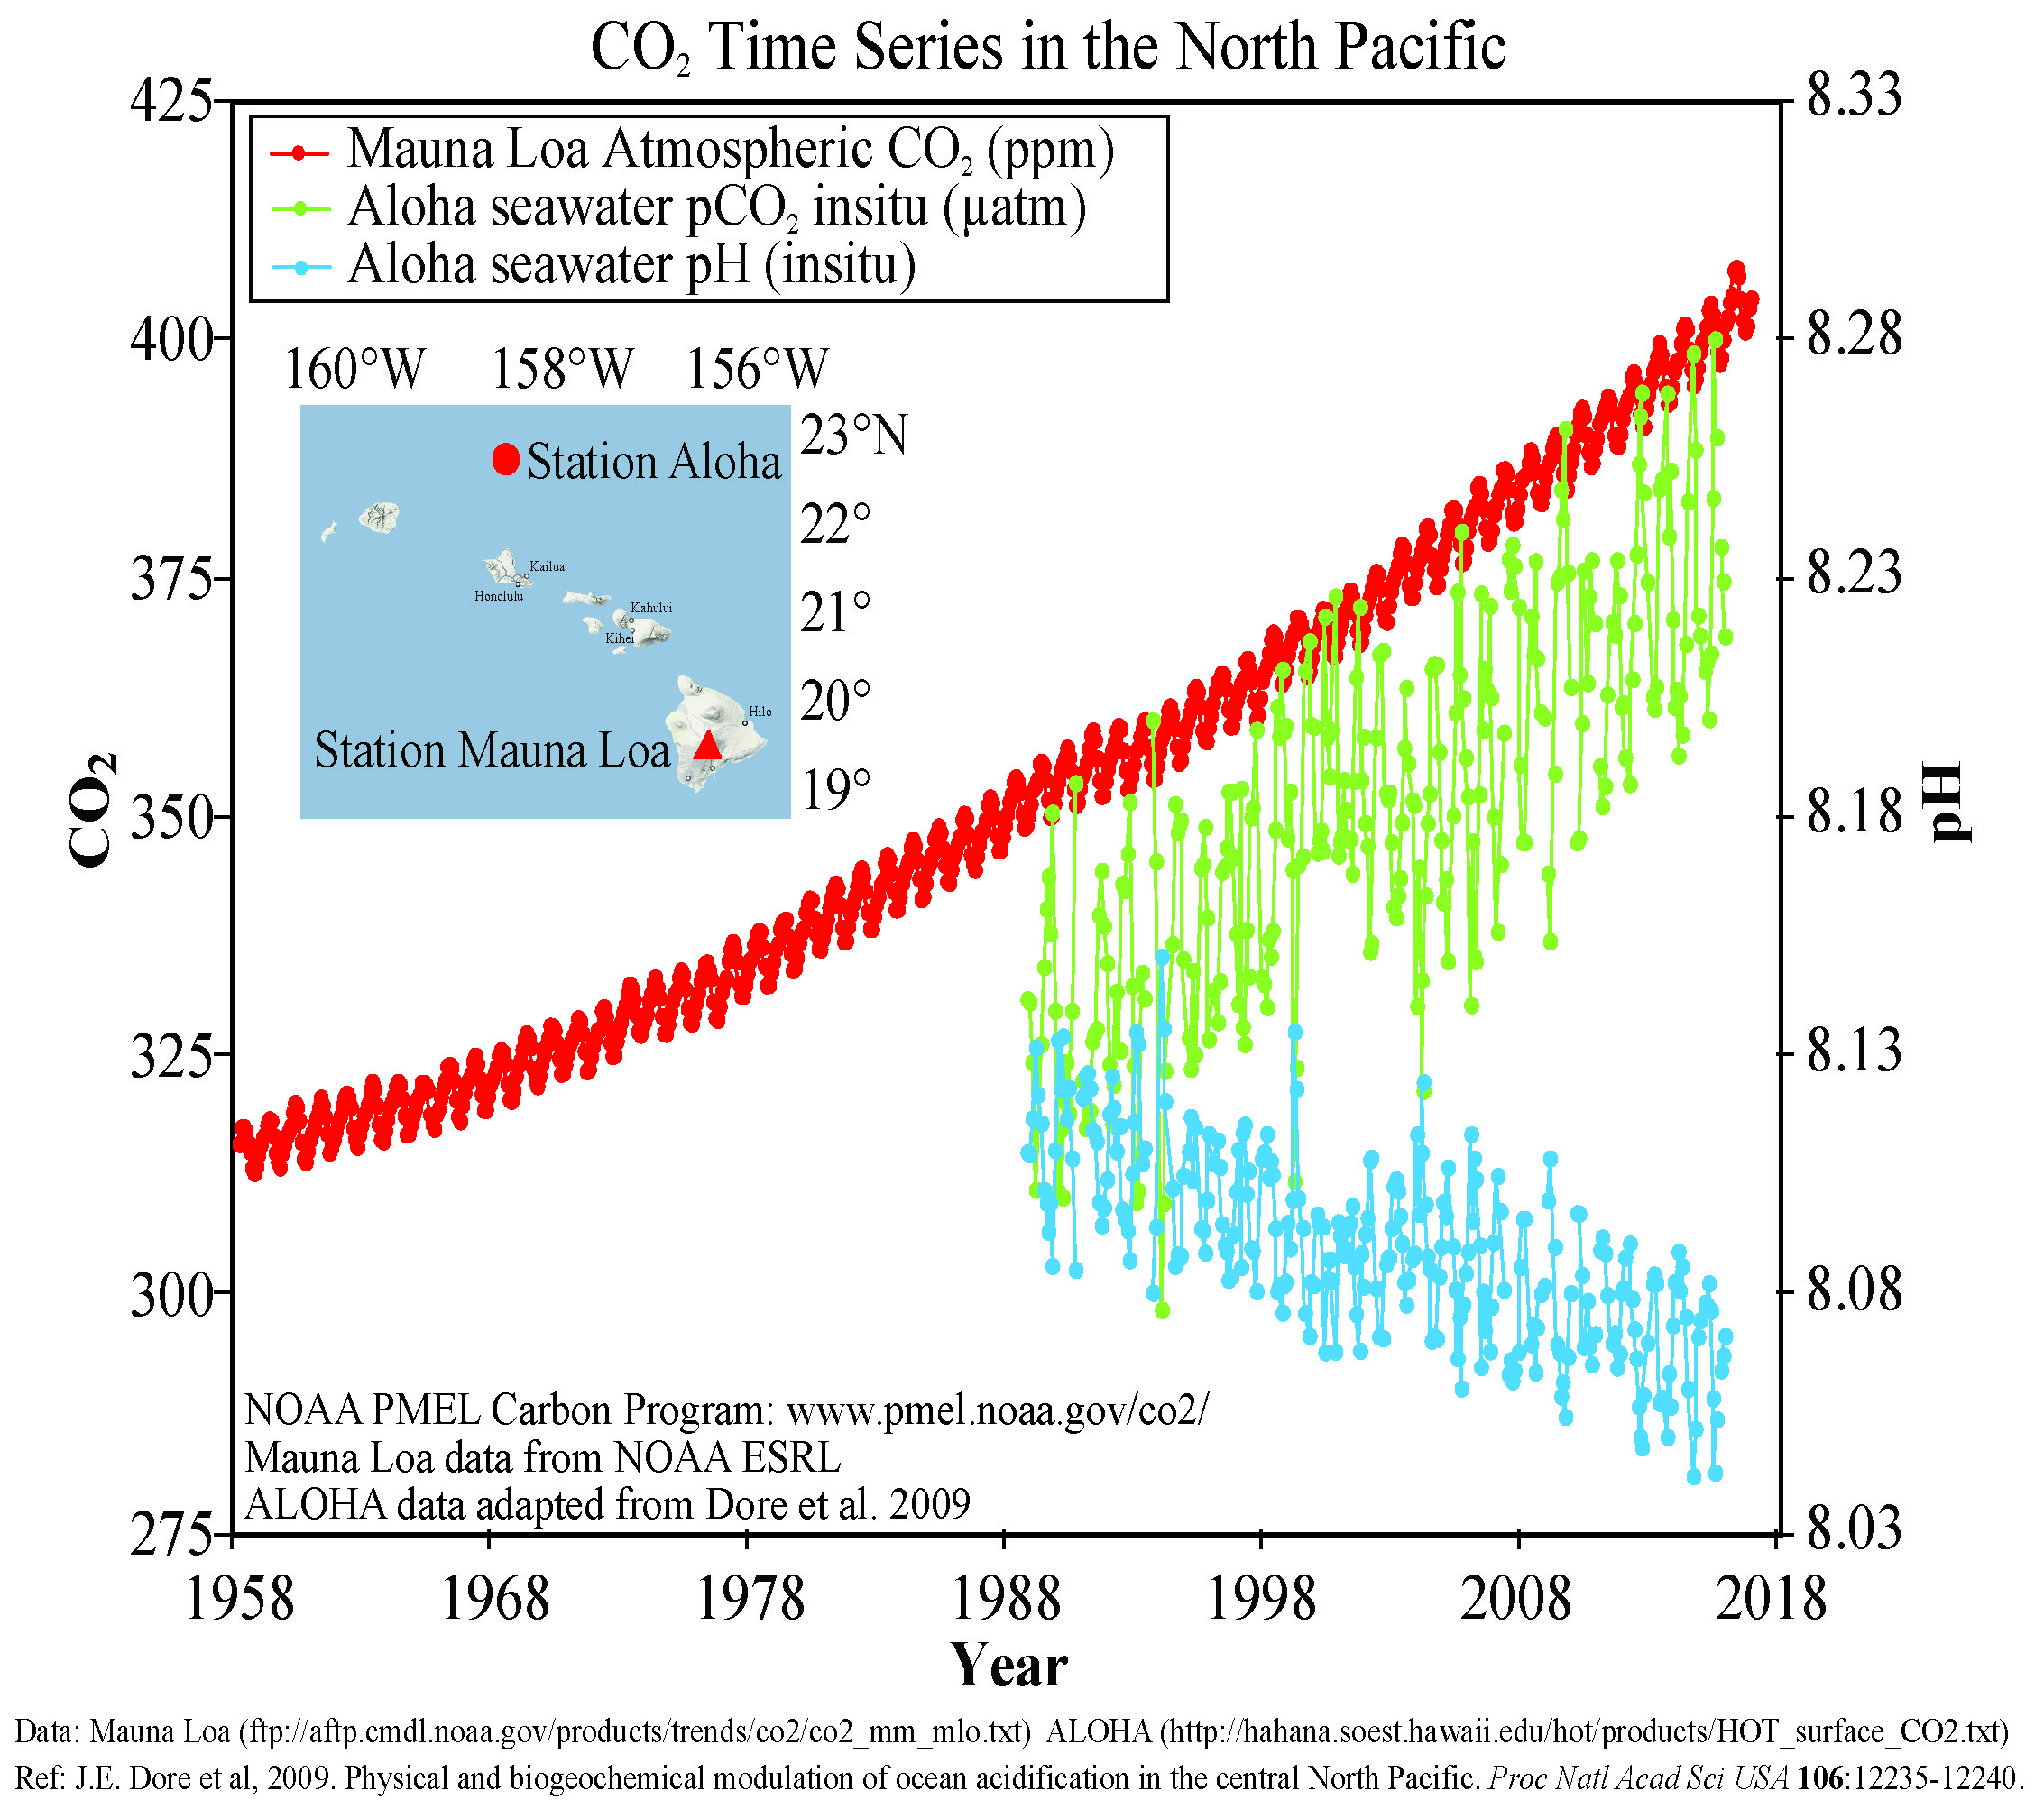
Impact of rising atmospheric CO₂ on ocean pH
CO₂ measured at Mauna Loa:
2016: 403 ppm
2022: 419 ppm
2023: 421 ppm
Pre-industrial ocean pH was 8.2
Pre-industrial atmospheric CO₂ was 290 ppm
Ocean pH:
2016: 8.06
…
https://www.researchgate.net/post/Is_the_Mauna_Loa_Observatory_Hawaii_records_for_C02_representative_of_Global_CO2_for_the_Earth_Atmosphere_Are_they_the_proof_of_GLOBAL_WARMING

Slide 7
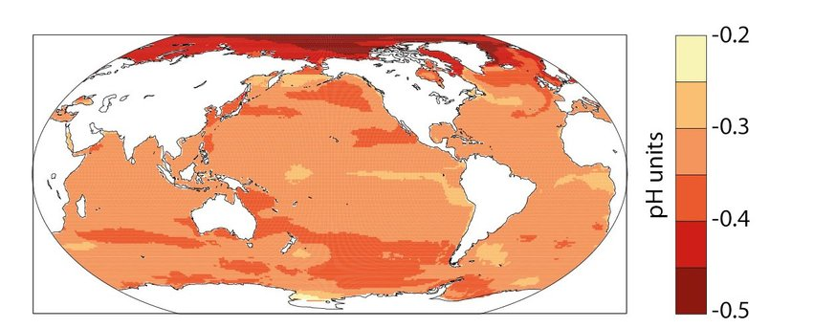
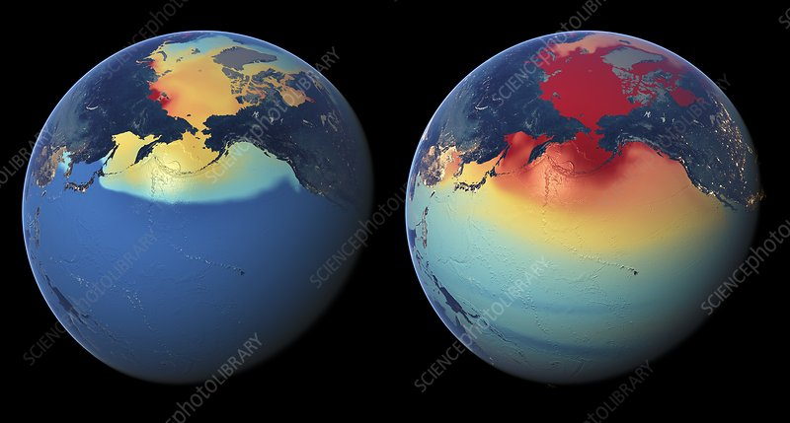
Which oceans are acidifying? It seems the Arctic is getting hit the most
https://www.researchgate.net/publication/328166919_A_new_climate_change_vulnerability_assessment_for_fisheries_and_aquaculture/figures?lo=1
Drop in pH
https://www.sciencephoto.com/media/684079/view

Slide 8
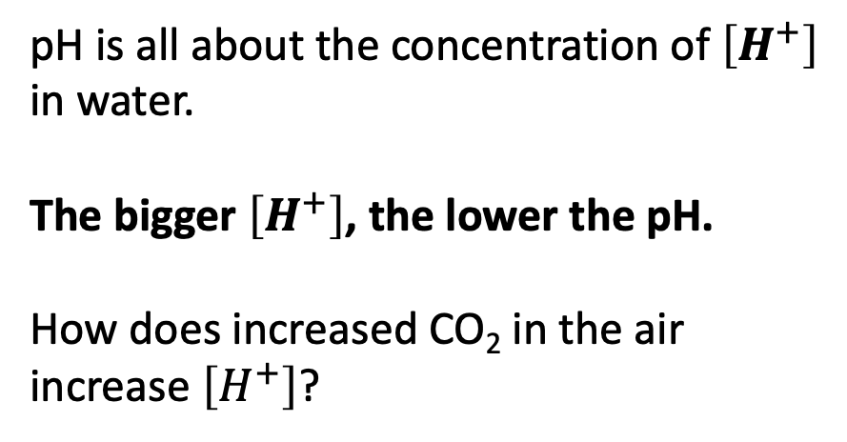
But how does that relate to the atmosphere? First, let’s assert that [H+] is proportional to the concentration of CO2 in the water,
[H+] = K [CO2]_w (2)
Relationship between pH and atmospheric CO₂
pH is all about the concentration of $\left[H^{+}\right]$ in water.
The bigger $\left[H^{+}\right]$, the lower the pH.
How does increased CO₂ in the air increase $\left[H^{+}\right]$?

Slide 9
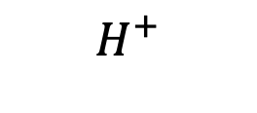
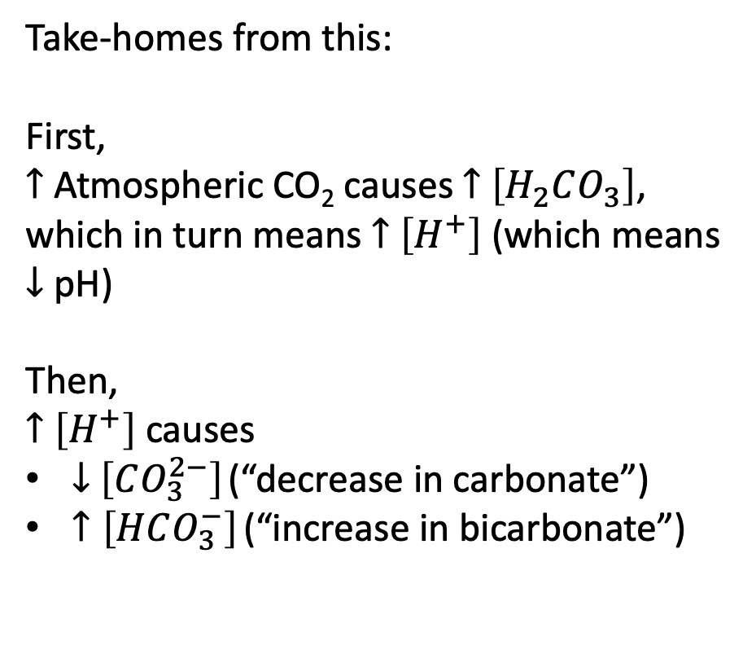
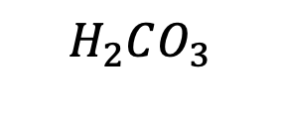
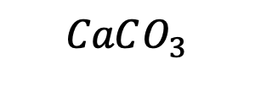
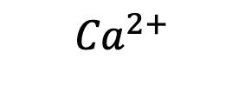
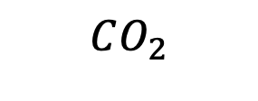
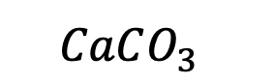
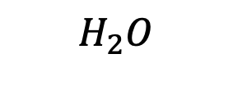
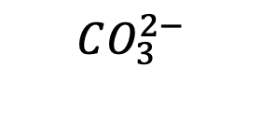
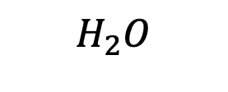
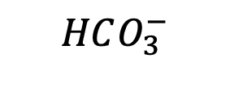

But how does that relate to the atmosphere? First, let’s assert that [H+] is proportional to the concentration of CO2 in the water,
[H+] = K [CO2]_w (2)
Cascade of carbonate reactions
Air
$$CO_{2}$$
Take-homes from this:
First,
$↑$ Atmospheric CO₂ causes $↑$ $\left[H_{2}CO_{3}\right]$, which in turn means $↑$ $\left[H^{+}\right]$ (which means $↓$ pH)
Then,
$↑$ $\left[H^{+}\right]$ causes
$↓$ $\left[CO_{3}^{2−}\right]$ (“decrease in carbonate”)
$↑\left[HCO_{3}^{−}\right]$ (“increase in bicarbonate”)
$$H_{2}O$$
$$H_{2}O$$
Oceans
$H_{2}CO_{3}$
$$H^{+}$$
$$H^{+}$$
$$HCO_{3}^{−}$$
$${Ca}^{2+}$$
$$CO_{3}^{2−}$$
Sea floor
$$CaCO_{3}$$
$$CaCO_{3}^{}$$

